Slide 1
Disjoint-Set (Union-Find)
Woodlands CS Club
03/15/2021

Slide 2
Introduction:
Disjoint set/Union find essentially refer to the same thing, so we’ll be using the term disjoint set for the remainder of the lesson.
What is a disjoint set?
A disjoint set is a data structure that supports two primary operations - find and unite.
Find - Given an element x, find which subset/group x belongs to
Unite - Join two subsets together
Why would we use a disjoint set?
There are many different applications for the disjoint set data structure. Refer to the next slide to view one of these examples, and then we’ll look at other uses.

Slide 3
Problem 1: https://dmoj.ca/problem/dmpg17s2
The question is asking us to support two operations:
Update our graph
Check if city x and y are connected
However, if we simply run a BFS/DFS for each check operation, our answer time for each query is O(V + E), meaning our overall complexity becomes O(QN + QE). Since N<=10⁵ and Q <=10⁵ this is too slow!
How can we answer queries more quickly? Also notice that it does not ask for distance between these nodes.

Slide 4
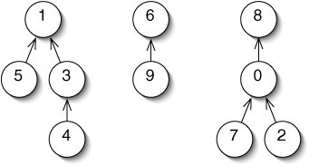
Disjoint Set Implementation
Since a disjoint set is comprised of multiple disjoint sets (hence the name), we have to find a way to differentiate between these different groups. We’ll store these groups in the form of trees (refer to the image below), and the root of the tree will be denoted as the parent of the set.
Thus, if two nodes have the same parent, they will be part of the same set.

Slide 5
Disjoint Set Implementation - Creating the Set
We’ll declare an array par in which par[x] will store node x’s parent. If x is the root node, then par[x] = x (we set itself as its parent node). This means when we are creating the set, we should initialize par[x] = x for the entire par array (all nodes begin in their own group).
For the example on the right:
par[0] = 8
par[1] = 1
par[2] = 0
par[3] = 1
par[4] = 3
par[5] = 1
par[6] = 6
par[7] = 0
par[8] = 8
par[9] = 6
The highlighted nodes are the root nodes of their respective set.

Slide 6
Disjoint Set Implementation - Creating the Set (Code)
Python:
par = [i for i in range(N+1)]
C++:
int par[N+1];
void create() {
for(int i=1;i<=N;i++)
par[i]=i;
}

Slide 7
Disjoint Set Implementation - Adding Find
As stated previously, the find operation simply returns which group node x belongs in. Since we represent each group as a tree, the find operation should simply return the root of the tree. We can do this through recursion: if the parent of x is equal to x, we return x, and otherwise, we recurse on the parent of x.
Python:
def find(x):
if(par[x] == x):
return x
return find(par[x])
C++:
int find(int x) {
if(par[x]==x)
return x;
return find(par[x]);
}

Slide 8
Disjoint Set Implementation - Adding Union
Now we have to figure out how to combine two groups in the set. The simplest way to do so is by first finding the root of each node. If these roots are not the same, then we simply assign one root’s parent to the other root.
For example, if we wanted to merge nodes 3 and 9 in the set to the right:
Step 1: Find which groups they belong to
a = find(9) // a = 6
b = find(3) // b = 1
Step 2: If they are part of different groups, assign one root’s parent to the other root
par[b] = a

Slide 9
Disjoint Set Implementation - Adding Union (Code)
Python:
def unite(x, y):
a = find(x)
b = find(y)
if(a!=b):
par[b] = a
C++:
void unite(int x, int y) {
int a = find(x);
int b = find(y);
if(a!=b) par[b] = a;
}

Slide 10
Problem 1: https://dmoj.ca/problem/dmpg17s2

Slide 11
DMPG '17 S2 - Anime Conventions
Python:
N, Q = map(int,input().split())
par = [i for i in range(N+1)]
def find(x):
if(par[x] == x):
return x
return find(par[x])
def unite(x, y):
a = find(x)
b = find(y)
if(a!=b):
par[b] = a
for i in range(Q):
op,x,y=input().split()
x,y=map(int,(x,y))
if(op=='A'):unite(x,y)
else:print(["N","Y"][find(x)==find(y)])
C++:
int N,Q,x,y,par[100003];
int find(int x) {
if(par[x]==x) return x;
return find(par[x]);
}
void unite(int x, int y) {
int a = find(x), b = find(y);
if(a!=b) par[b] = a;
}
int main() {
cin>>N>>Q;
for(int i=1;i<=N;i++) par[i]=i;
while(Q--) {
char op; cin >> op >> x >> y;
if(op=='A') unite(x,y);
else cout<<(find(x)==find(y)?"Y\n":"N\n");
}
}

Slide 12
Disjoint Set Implementation - Time Complexity
Currently, the time complexity of our find operation is O(N) since our unite function can create trees with large depths.
Although this is fast enough for some problems, there a few optimizations we can make to improve this complexity.
Both of the following optimizations improve this complexity to O(logN) time per call, however, neither proof will be shown.

Slide 13
Optimization 1: Path Compression
The first optimization we make is based on the following observation:
If we call the find operation on a node x, then the parent of all the nodes we visit on the path from x to the root of that tree is the root.
This is more clear with an example. If we call find(4) on the graph below, then our path will visit nodes (4, 3, 1, 6) in order. We notice that the root of the tree for nodes 4, 3, and 1 are all equal to 6. Thus, we can optimize our find function by setting the parent of each of these nodes in the path directly to the root.
After we call find(4), the following modifications to our par array are made:
par[4] = 6
par[3] = 6
par[1] = 6
We improve our complexity from O(N) → O(logN)

Slide 14
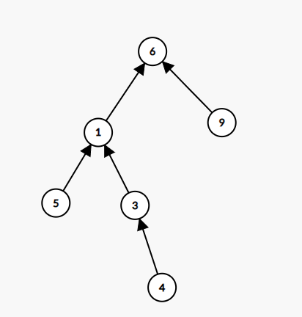
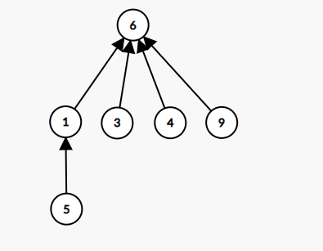
Optimization 1: Path Compression Visualization
Original
After find(4)

Slide 15
Path Compression Code (Change Find Function)
Python:
def find(x):
root = x
while(root != par[root]): root = par[root]
while(x != root):
nxt = par[x]
par[x] = root
x = nxt
return root
C++:
int find(int x) {
int root = x;
while(root != par[root]) root = par[root];
// now we path compress since we found root
while (x != root) {
int next = par[x];
par[x] = root;
x = next;
}
return root;
}

Slide 16
Optimization 1: Unite by Size
This optimization changes how we join two groups. In our previous code, we always assign the root of group b’s parent to the root of group a. However, this is non-optimal since this could result in creating a tree with a large depth.
Instead, this optimization creates a size array which maintains the size of the node’s group. Then, when we want to merge two groups, we set the root of the group with the smaller size to the root of the larger group.
Note that this requires us to create a separate array size. When first creating the disjoint set, we must initialize the entire array to 1.

Slide 17
Unite by Size Code (Change Unite Function)
Python:
def unite(x, y):
a = find(x)
b = find(y)
if(a!=b):
if(size[a] < size[b]):
a, b = b, a
size[a] += size[b]
par[b] = a
C++:
void unite(int x, int y) {
int a = find(x), b = find(y);
if(a!=b) {
if(size[a] < size[b]) swap(a, b);
size[a] += size[b];
par[b] = a;
}
}

Slide 18
Disjoint Set Implementation - Time Complexity
After combining both optimizations, our queries (find operation) can be handled in nearly constant time.
However, only using one of these optimizations will handle queries in an average of O(logN) time.
A cheat sheet of the time complexities can be found below:
Optimization | Time Complexity (Per Query)
Naive | O(N)
Path Compression or Unite by Size | O(logN)
Path Compression and Unite by Size | O(α(n))

Slide 19
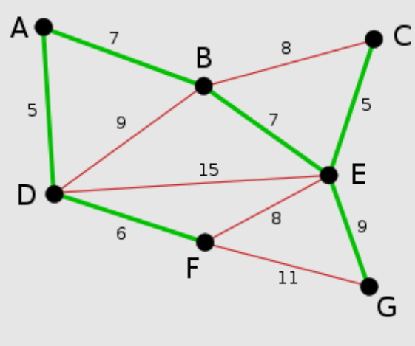
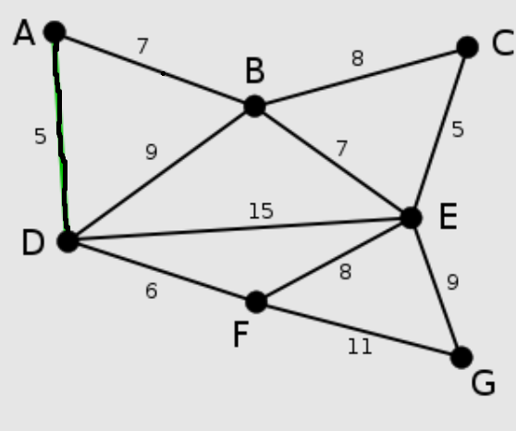
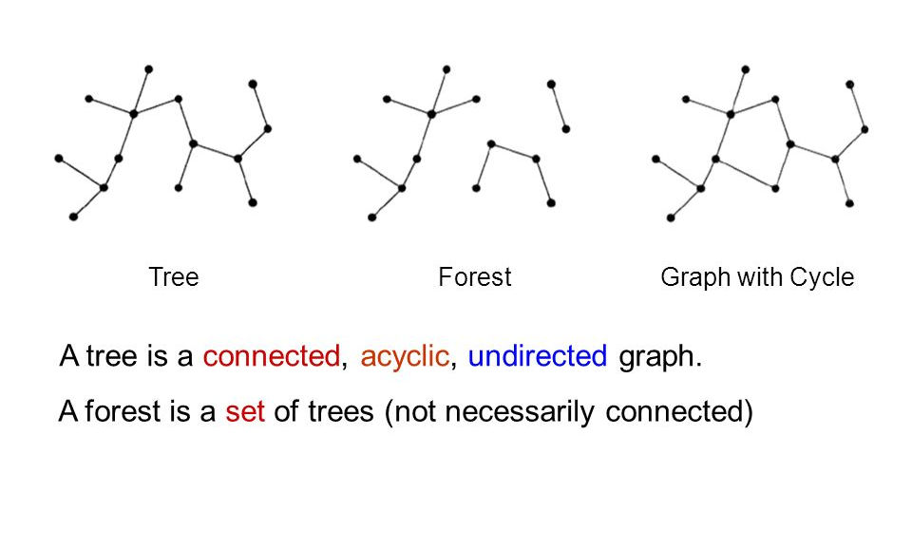
Kruskal’s Algorithm
Algorithm to find the minimum spanning forest
Graph needs to be undirected and edge-weighted
Minimum spanning tree: subset of edges that includes every vertex (with sum of edge weights being minimal)
Trees have no cycles (one path between any two nodes)
*Tree = 1 connected component, forest = multiple trees / connected components

Slide 20
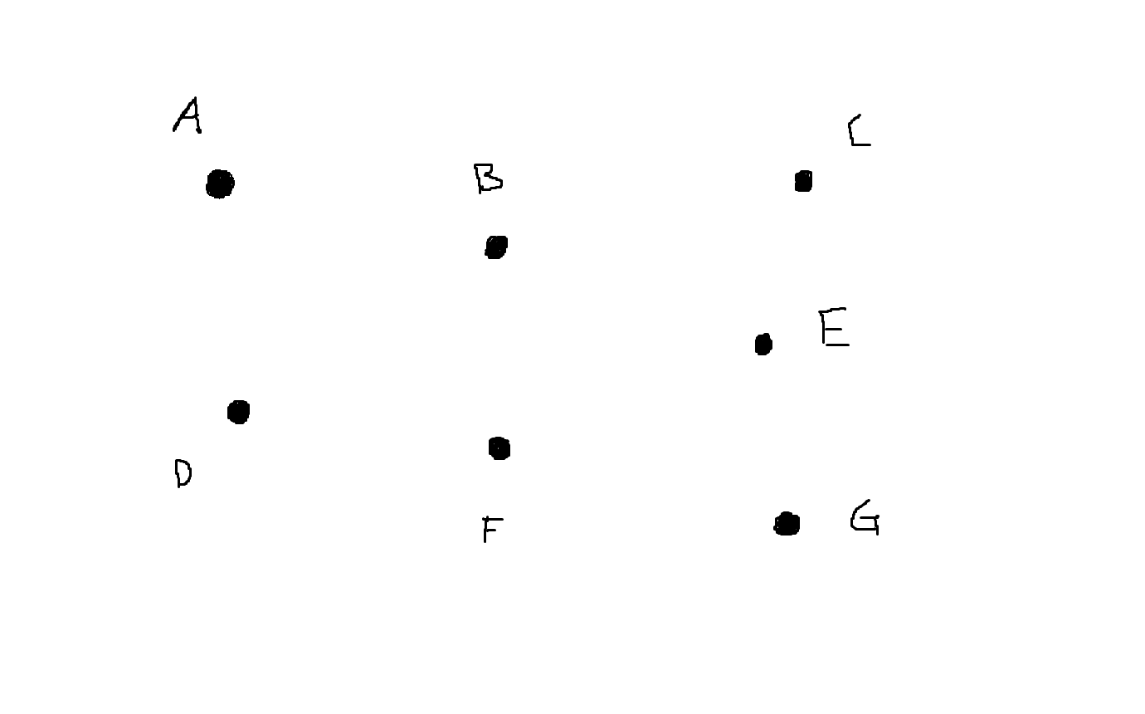
Initial tree starts with only vertices
Sort edges by weight
Go through edges
Add to tree if doesn’t form a cycle
Edge list
A - B: 7
A - D: 5
B - C: 8
B - D: 9
B - E: 7
C - E: 5
D - E: 15
D - F: 6
E - F: 8
E - G: 9
F - G: 11
A - D: 5
C - E: 5
D - F: 6
A - B: 7
B - E: 7
B - C: 8
E - F: 8
B - D: 9
E - G: 9
F - G: 11
D - E: 15

Slide 21
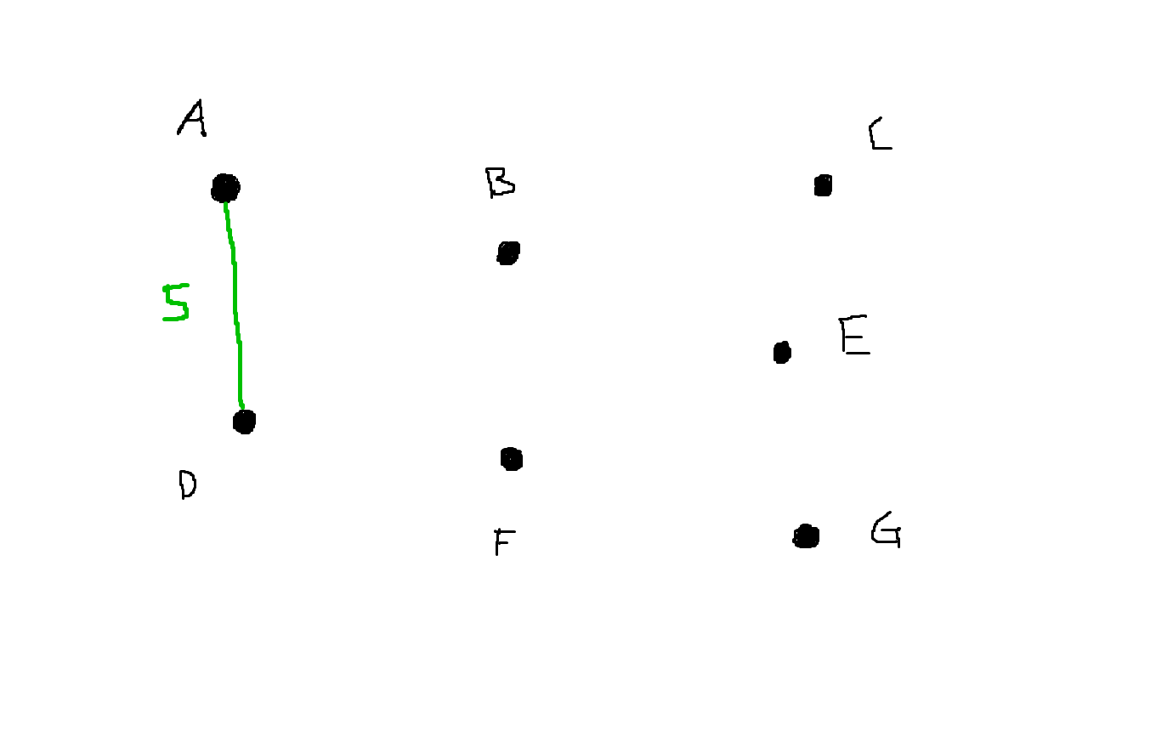
Initial tree starts with only vertices
Sort edges by weight
Go through edges
Add to tree if doesn’t form a cycle
Edge list
A - D: 5
C - E: 5
D - F: 6
A - B: 7
B - E: 7
B - C: 8
E - F: 8
B - D: 9
E - G: 9
F - G: 11
D - E: 15

Slide 22
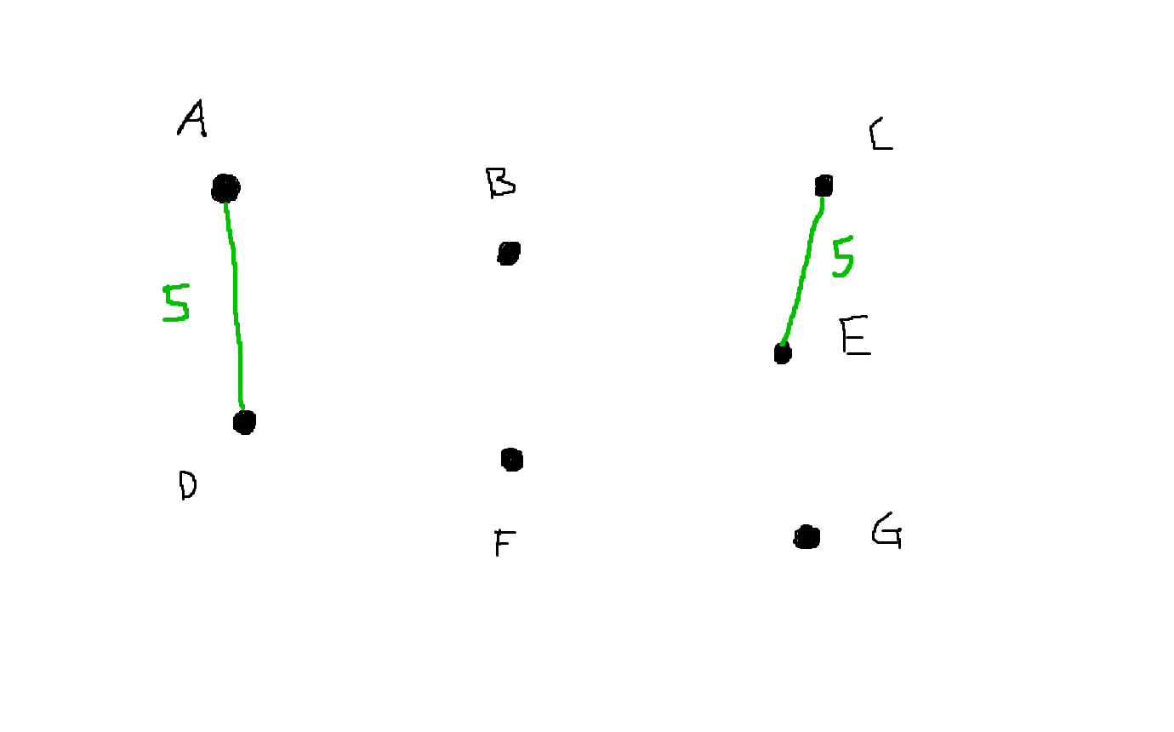
Initial tree starts with only vertices
Sort edges by weight
Go through edges
Add to tree if doesn’t form a cycle
Edge list
A - D: 5
C - E: 5
D - F: 6
A - B: 7
B - E: 7
B - C: 8
E - F: 8
B - D: 9
E - G: 9
F - G: 11
D - E: 15

Slide 23
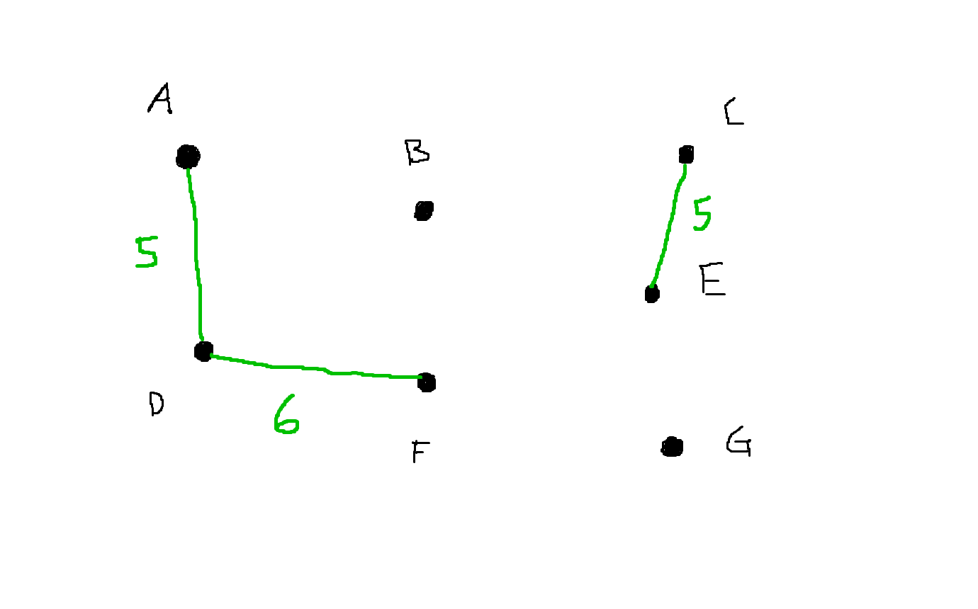
Initial tree starts with only vertices
Sort edges by weight
Go through edges
Add to tree if doesn’t form a cycle
Edge list
A - D: 5
C - E: 5
D - F: 6
A - B: 7
B - E: 7
B - C: 8
E - F: 8
B - D: 9
E - G: 9
F - G: 11
D - E: 15

Slide 24
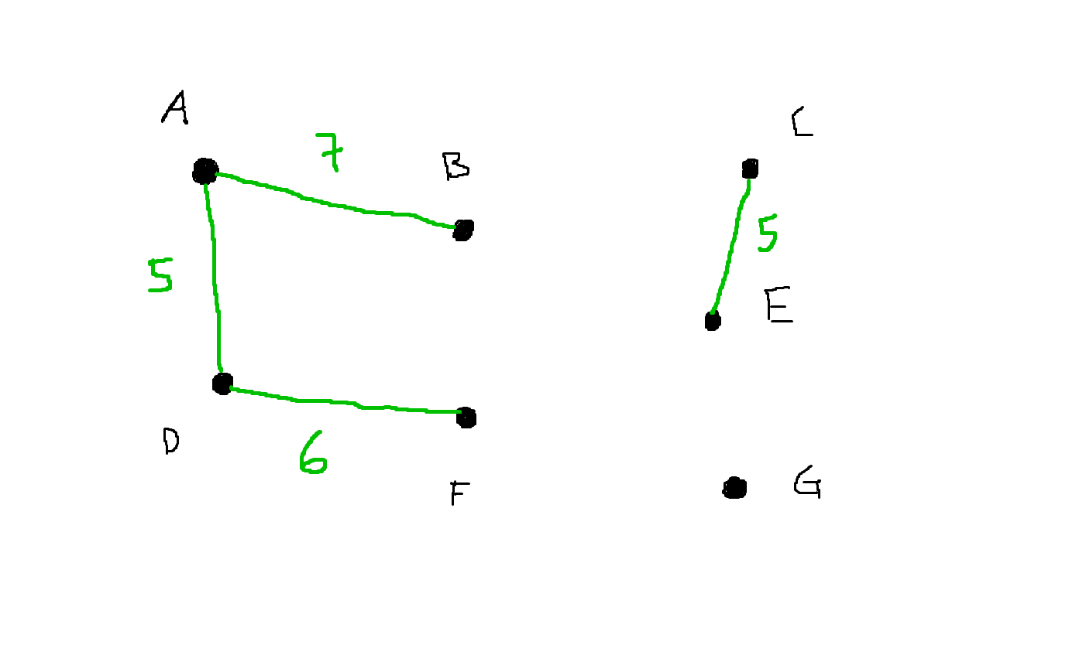
Initial tree starts with only vertices
Sort edges by weight
Go through edges
Add to tree if doesn’t form a cycle
Edge list
A - D: 5
C - E: 5
D - F: 6
A - B: 7
B - E: 7
B - C: 8
E - F: 8
B - D: 9
E - G: 9
F - G: 11
D - E: 15

Slide 25
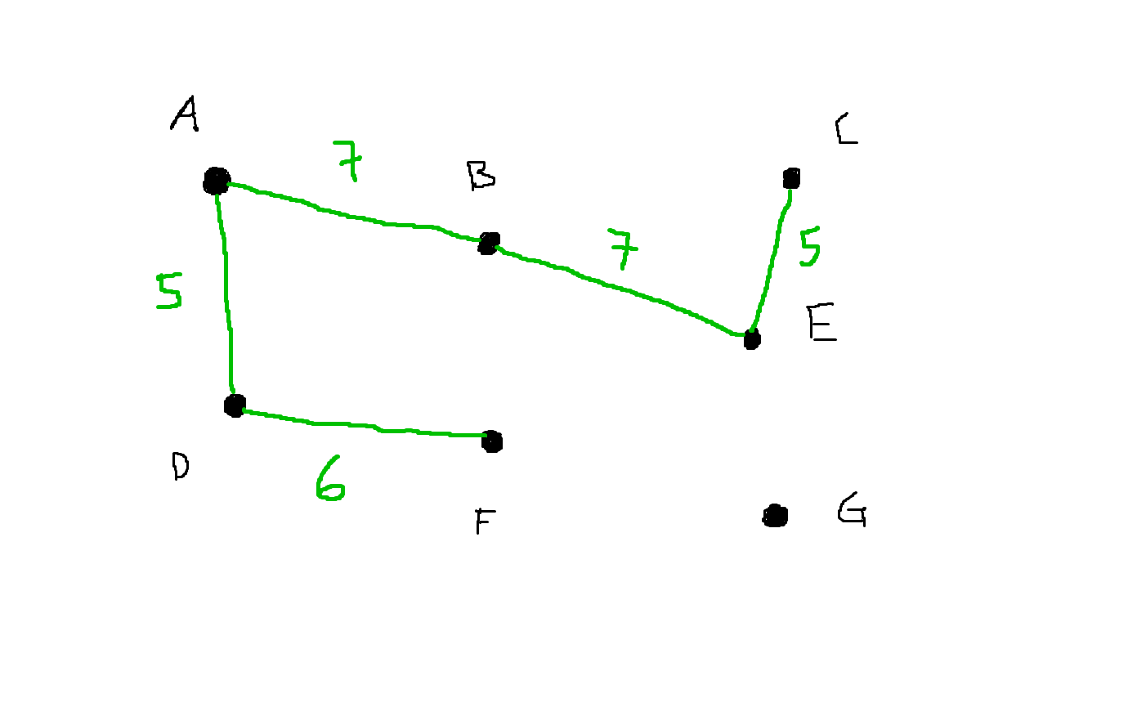
Initial tree starts with only vertices
Sort edges by weight
Go through edges
Add to tree if doesn’t form a cycle
Edge list
A - D: 5
C - E: 5
D - F: 6
A - B: 7
B - E: 7
B - C: 8
E - F: 8
B - D: 9
E - G: 9
F - G: 11
D - E: 15

Slide 26
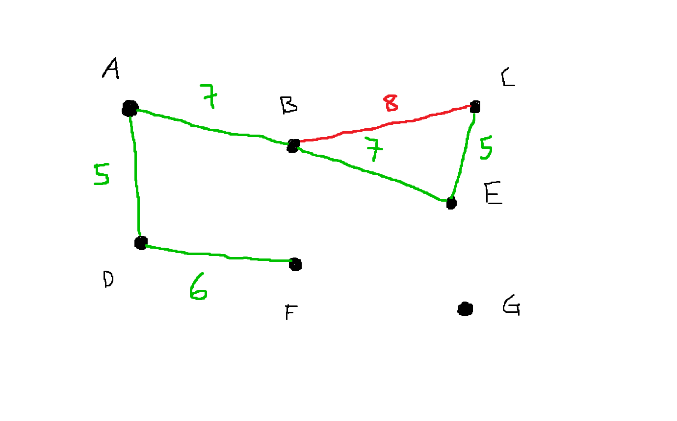
Initial tree starts with only vertices
Sort edges by weight
Go through edges
Add to tree if doesn’t form a cycle
Edge list
A - D: 5
C - E: 5
D - F: 6
A - B: 7
B - E: 7
B - C: 8
E - F: 8
B - D: 9
E - G: 9
F - G: 11
D - E: 15

Slide 27
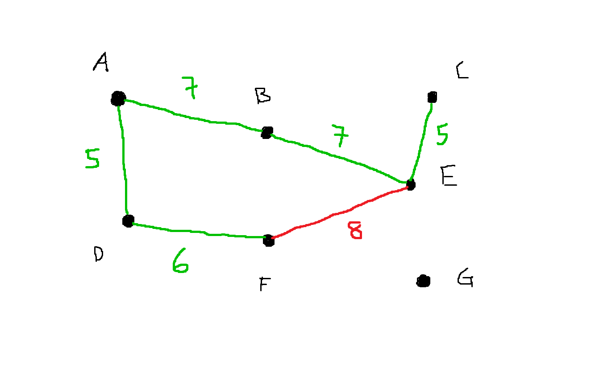
Initial tree starts with only vertices
Sort edges by weight
Go through edges
Add to tree if doesn’t form a cycle
Edge list
A - D: 5
C - E: 5
D - F: 6
A - B: 7
B - E: 7
B - C: 8
E - F: 8
B - D: 9
E - G: 9
F - G: 11
D - E: 15

Slide 28
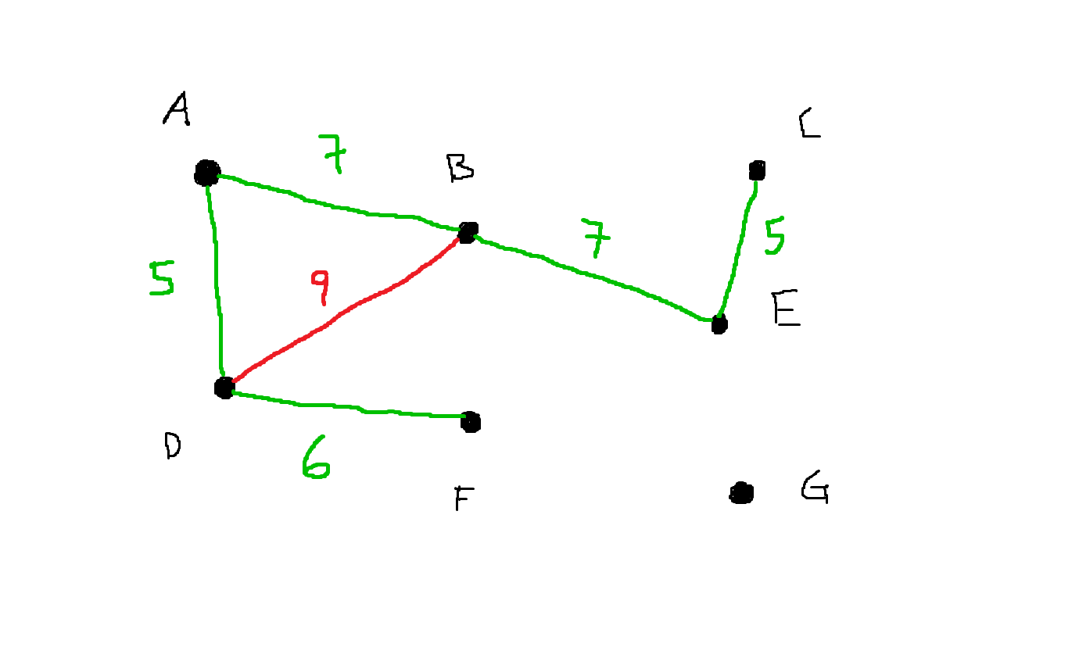
Initial tree starts with only vertices
Sort edges by weight
Go through edges
Add to tree if doesn’t form a cycle
Edge list
A - D: 5
C - E: 5
D - F: 6
A - B: 7
B - E: 7
B - C: 8
E - F: 8
B - D: 9
E - G: 9
F - G: 11
D - E: 15

Slide 29
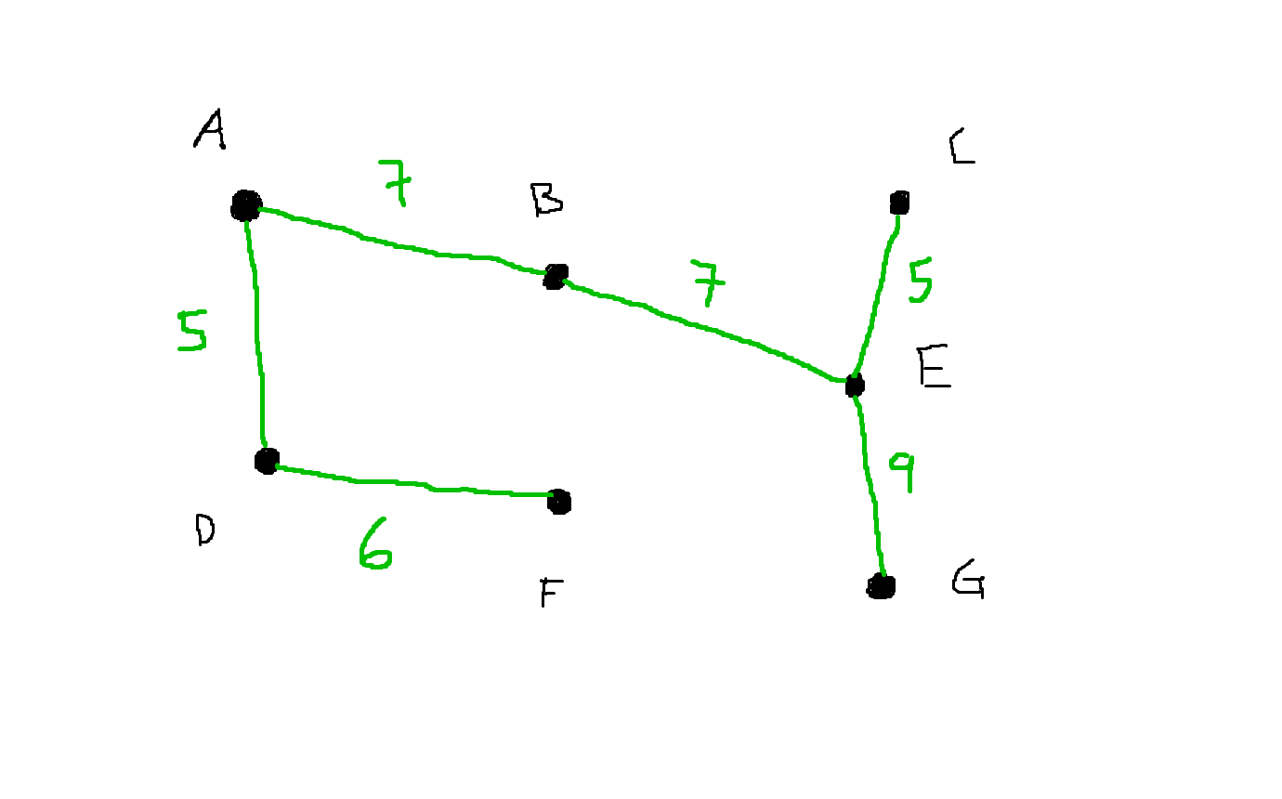
Initial tree starts with only vertices
Sort edges by weight
Go through edges
Add to tree if doesn’t form a cycle
Edge list
A - D: 5
C - E: 5
D - F: 6
A - B: 7
B - E: 7
B - C: 8
E - F: 8
B - D: 9
E - G: 9
F - G: 11
D - E: 15
Can break here as you already have N-1 edges in MST

Slide 30
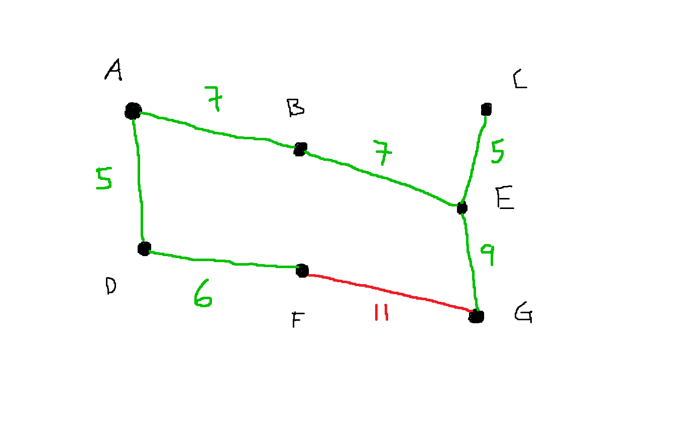
Initial tree starts with only vertices
Sort edges by weight
Go through edges
Add to tree if doesn’t form a cycle
Edge list
A - D: 5
C - E: 5
D - F: 6
A - B: 7
B - E: 7
B - C: 8
E - F: 8
B - D: 9
E - G: 9
F - G: 11
D - E: 15

Slide 31
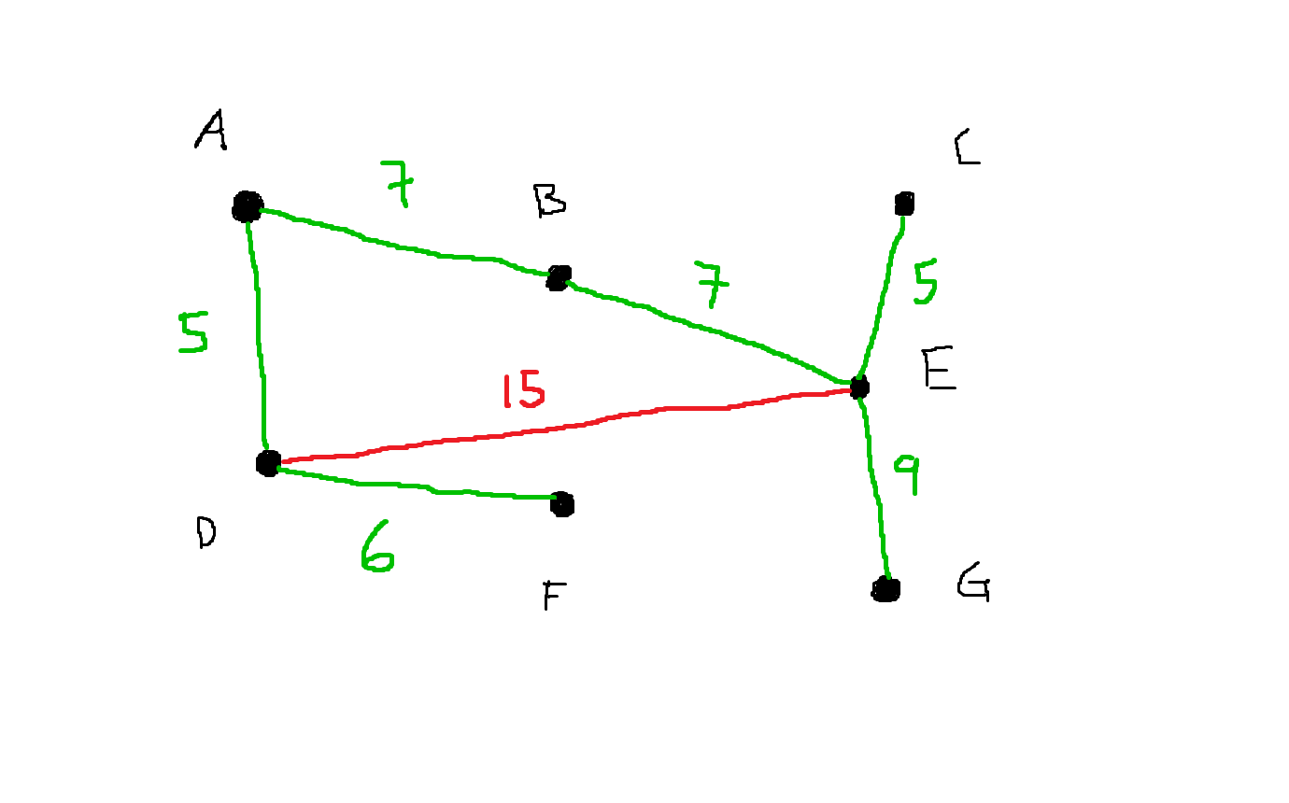
Initial tree starts with only vertices
Sort edges by weight
Go through edges
Add to tree if doesn’t form a cycle
Edge list
A - D: 5
C - E: 5
D - F: 6
A - B: 7
B - E: 7
B - C: 8
E - F: 8
B - D: 9
E - G: 9
F - G: 11
D - E: 15

Slide 32
https://dmoj.ca/problem/dmopc15c6p4

Slide 33
